Slide 1
Quantum Computing in NLP
Group 4:
Kishan Vaishnani - 202011004
Dhyanil Mehta - 202011032
Darshil Patel - 202011034
Aakash Dhedhi - 202011053
Tarang Ranpara - 202011057

Slide 2
Quantum Computing overview and Math

Slide 3
Overview
Quantum computing represents a new paradigm in computation that utilizes the fundamental principles of quantum mechanics to perform calculations.
promise of quantum computation lies in the possibility of efficiently performing a handful of tasks such as prime factorization, quantum simulation, search, optimization, and algebraic programs such as machine learning.
The strength of QC comes in its capability of it being able to represent float numbers upto virtually infinite precision. (inherently analog nature)

Slide 4
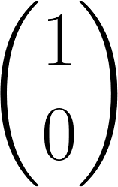

Dirac Notation
Let's assume we live in a 2D world
Zero
One

Slide 5
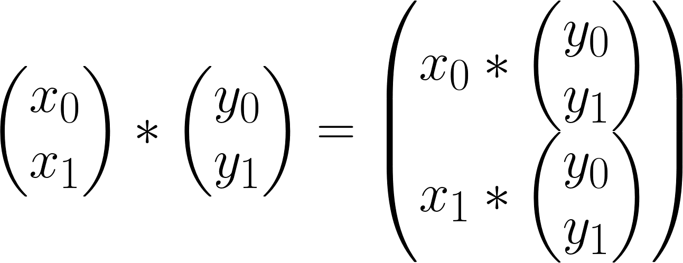
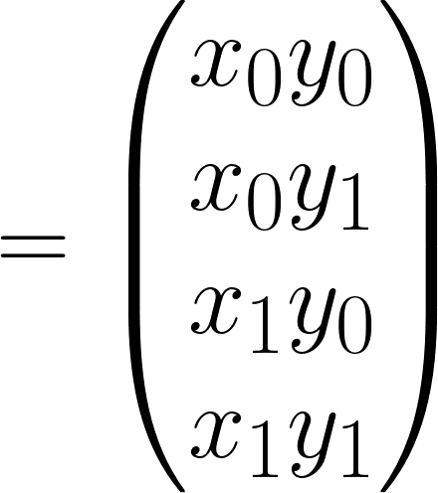
Tensor product

Slide 6
Operations on 1 bit
Identity
Negation
Set - 0
Set - 1

Slide 7
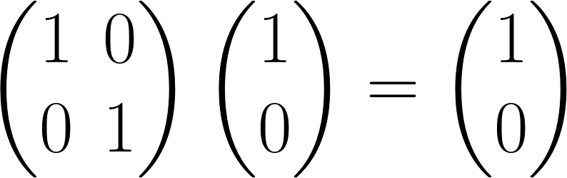
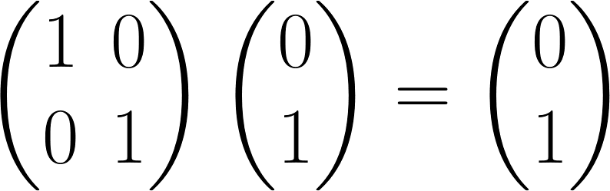
Identity

Slide 8
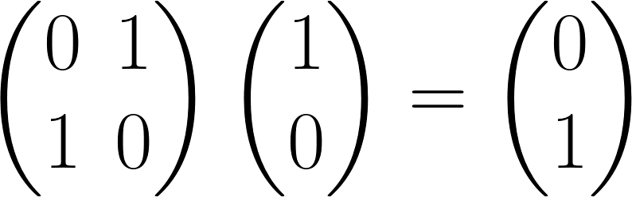
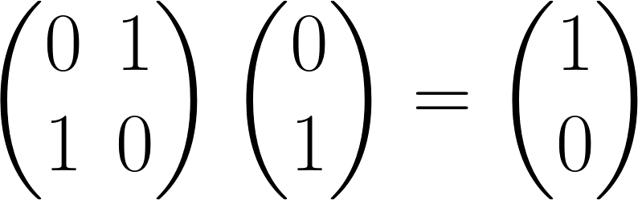
2. Negation

Slide 9
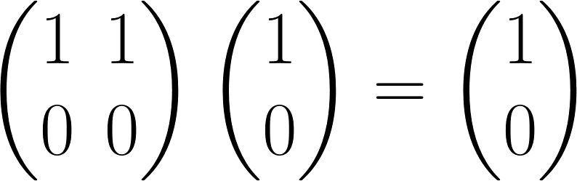
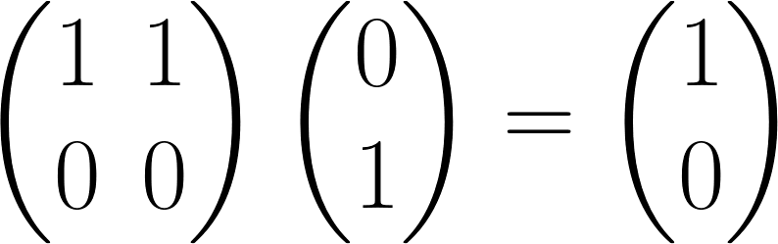
3. Set - 0

Slide 10
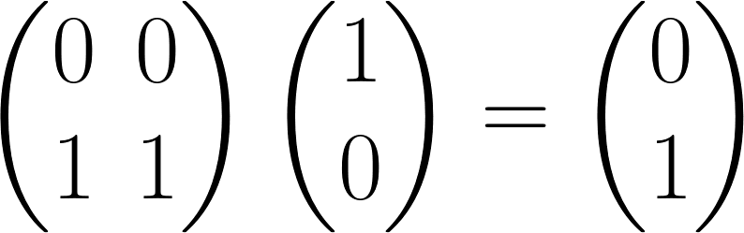
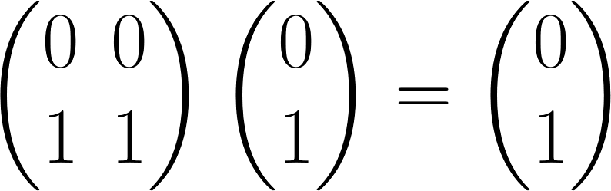
4. Set - 1

Slide 11
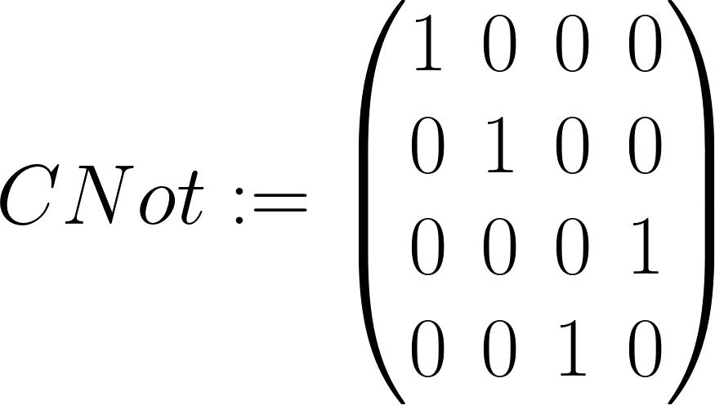
Conditional Not Gate
MSB: Control bit
LSB: Target bit

Slide 12
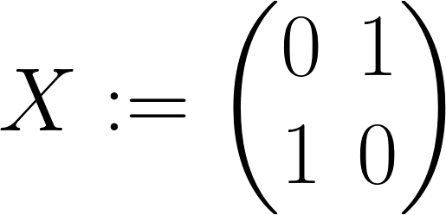
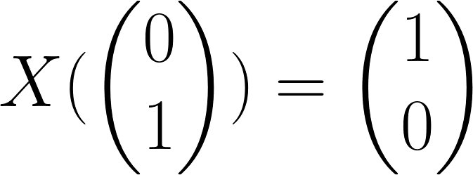
Bit Flip Operation
Definition:
Example:

Slide 13
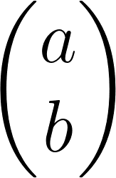
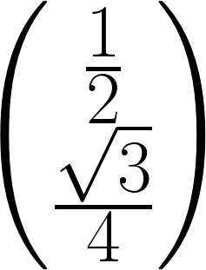
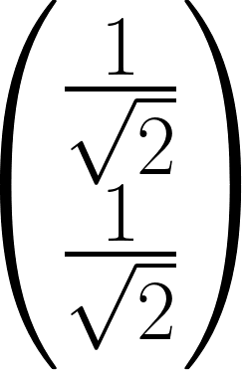
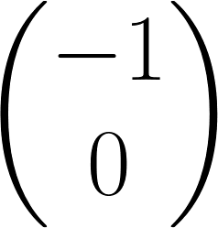
Quantum bit (Qubit)
Def:
is a Qubit if ||a||² + ||b||² = 1, Where a & b are complex numbers.
Cbit is a special case of Qubit
Example:

Slide 14
Super Position
The Qubit is not 0 or 1, but it's the squared sum of it comes out to be 1.
Does not mean they are 0 & 1 at the same time?
This is called “Superposition” (Schrödinger’s cat!)

Slide 15
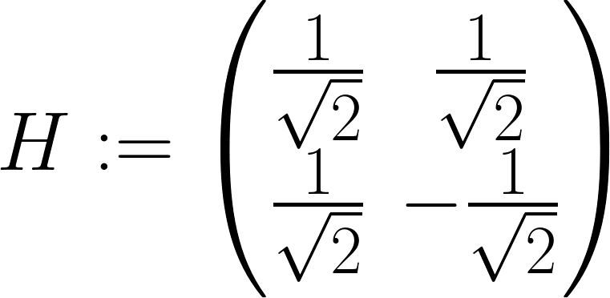
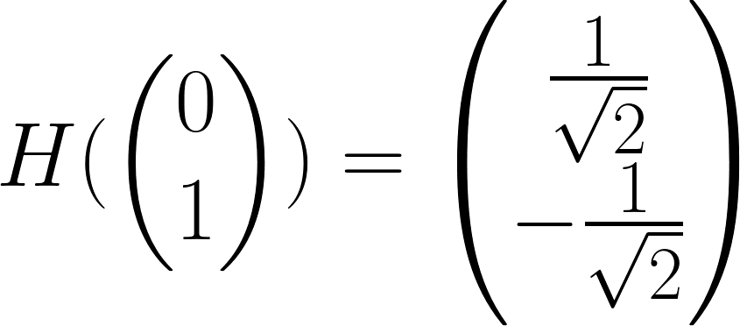
Hadamard Product
Definition:
Example:

Slide 16
Collapsing
When we “observe” the qbit, it is “collapses” to either 0 or 1 (Not automatically)
As we understand onl the classical reality, we make this bit collapse to either 0 or 1 at the end of computation!
Simplest collapsing circuit can be probability based one,
Has a² probability of collapsing to 0, and b² of collapsing to 1

Slide 17
Classical QC problem:
Deutsche Oracle problem

Slide 18
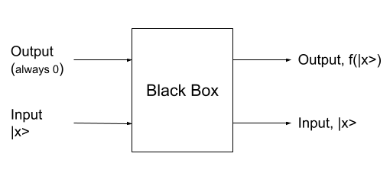
2-wire model
To make any operation reversible!

Slide 19
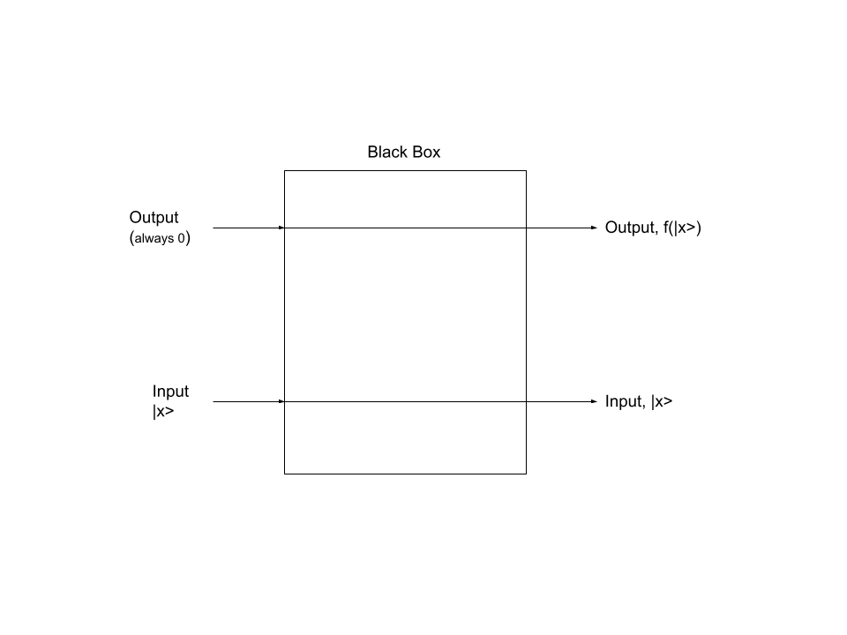
Output-0

Slide 20
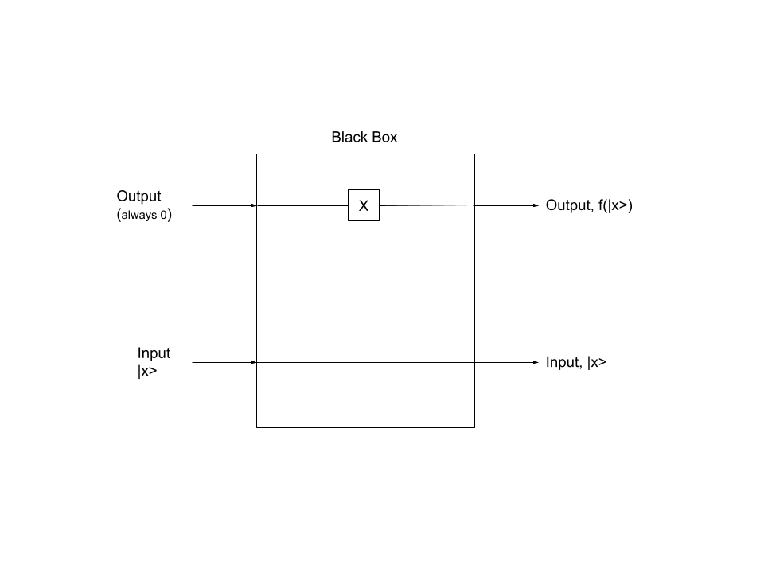
Output-1

Slide 21
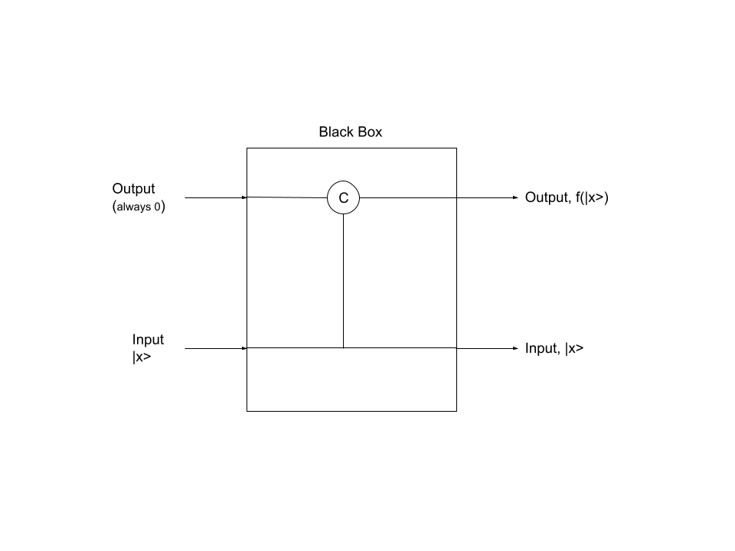
Identity

Slide 22
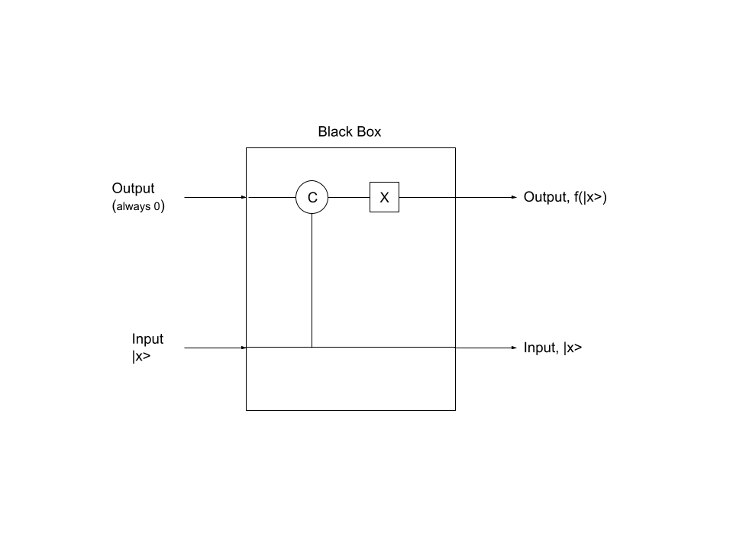
Negation

Slide 23
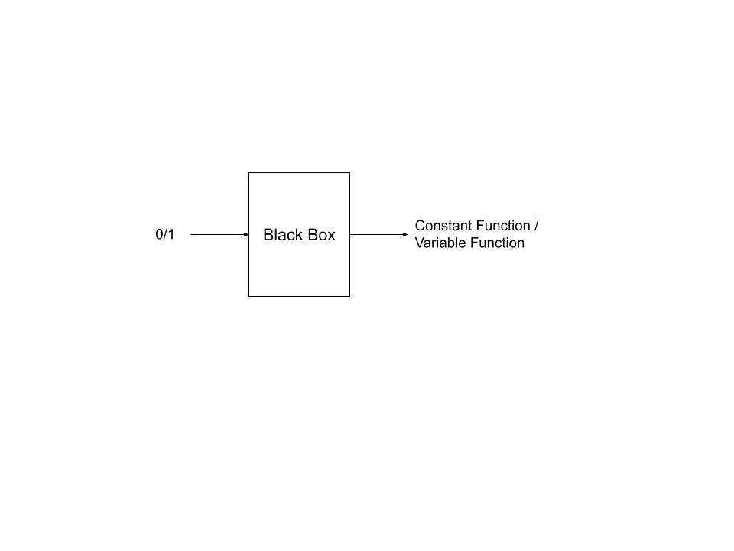
Deutsche Oracle Problem
There’s a black box where there can be one of the following functions
Set 1, set 0, negation, identity
Black box has to return if the function inside is constant or variable
Rule:
You can only feed the query & record the output
How many times human has to repeat the above experiment to solve the problem?
Human would take 2 attempts!
Quantum computer would take only 1!!

Slide 24
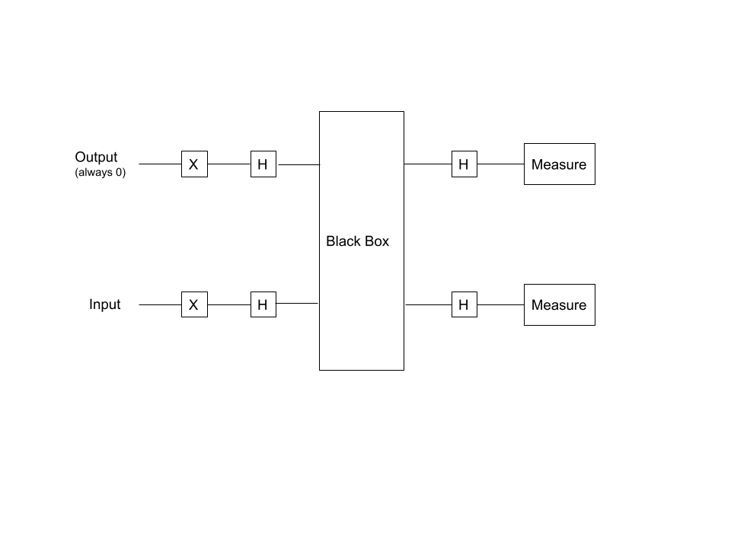
Circuit Diagram

Slide 25
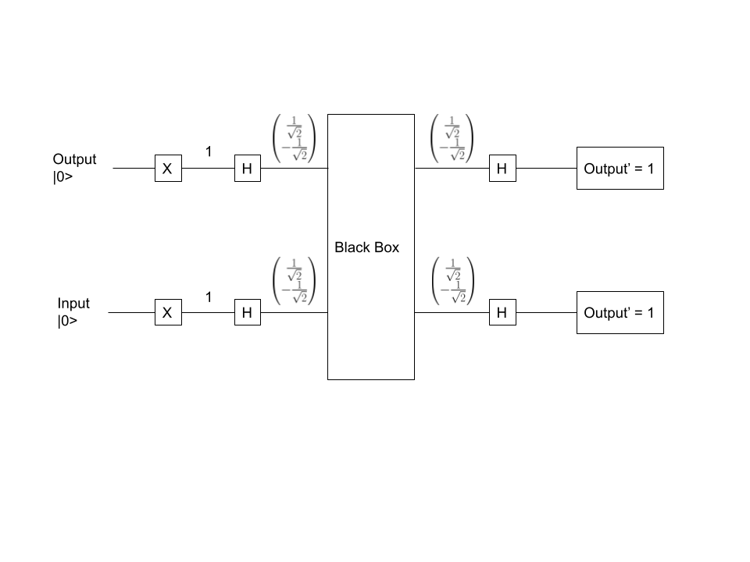
Set - 0

Slide 26
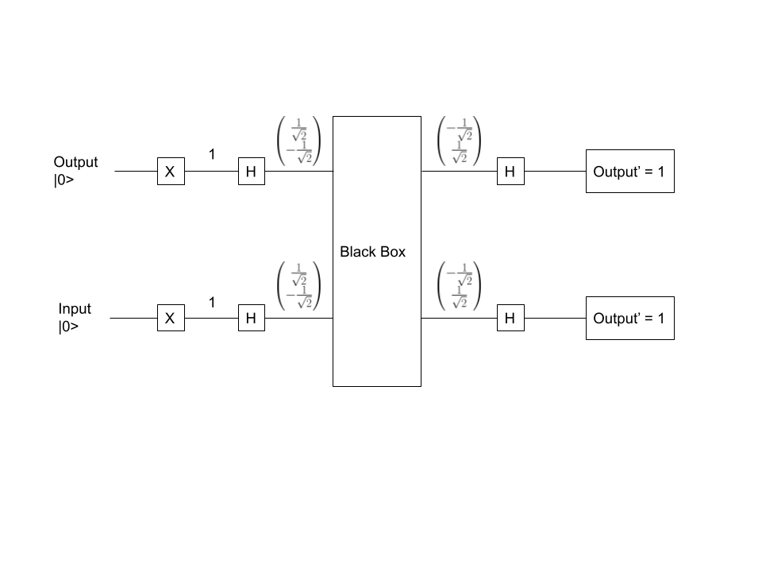
Set - 1

Slide 27
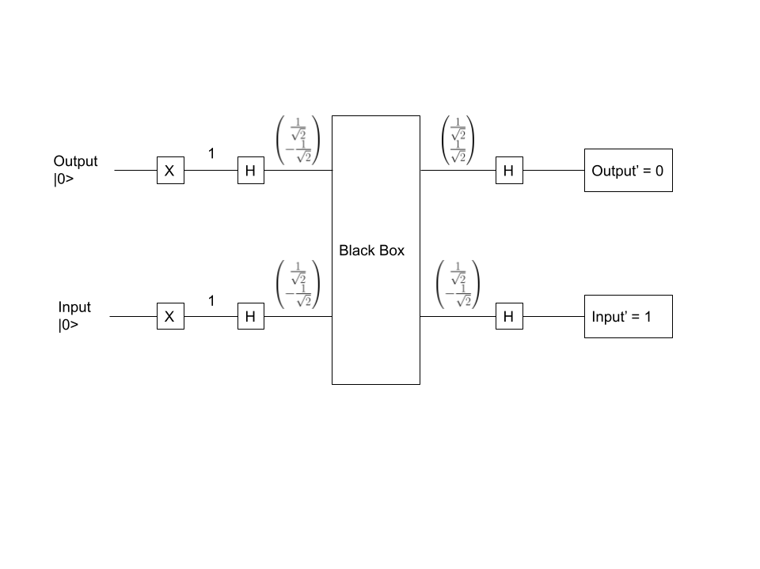
Identity

Slide 28
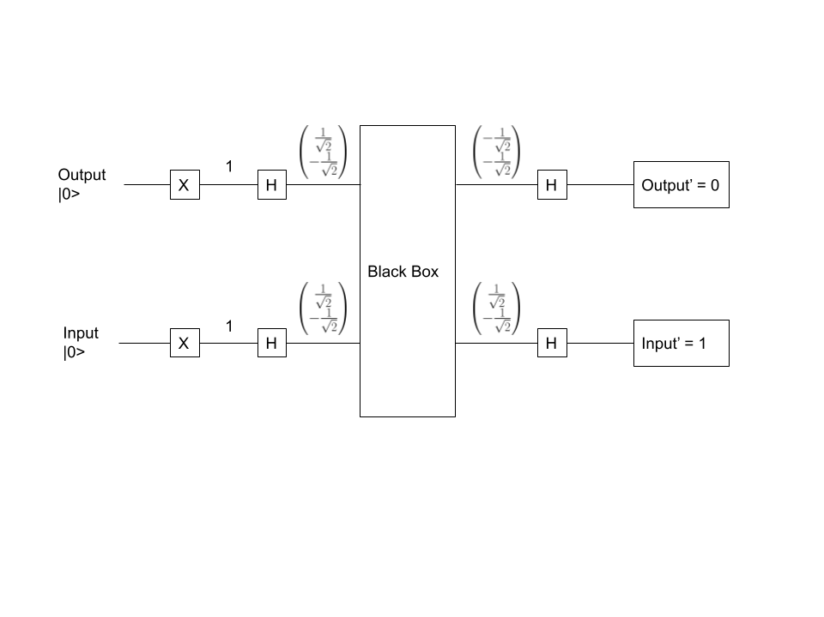
Negation

Slide 29
Results
Input | Constant Function | Variable Function
0 | |11> | |01>
1 | |10> | |11>

Slide 30
QT: QUANTUM TRANSFORMER!

Slide 31
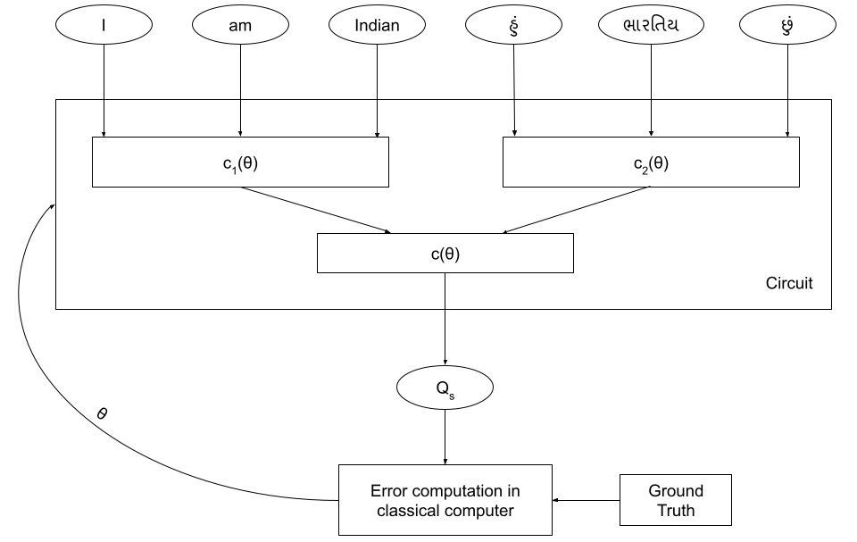
Θ : Parameter
Q_{s} : Quantum State
C₁(θ), C₂(θ), C(θ) : Quantum circuit having reversible functions
QT Training

Slide 32
Algorithm: Training
Input_{source} <- Quantum representation of source input tokens
Input_{Target} <- Quantum representation of target input tokens
For ( epochs ) :
Q_{s} = C_{(θ)} ( C_{(θ)1}( Input_{source} ) , C_{(θ)2} ( Input_{Target} ) )
R_{s} = collapseCircuit ( Q_{s} )
Θ = lossFunction ( R_{s} , groundTruth)
epochs --

Slide 33
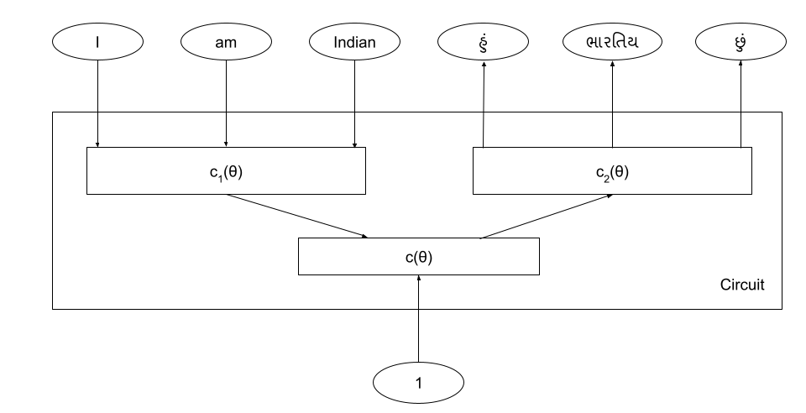
Θ : Parameter
Q_{s} : Quantum State
C₁(θ), C₂(θ), C(θ) : Quantum circuit having reversible functions
QT Inference

Slide 34
Algorithm: Inference
Input_{source} <- Quantum representation of source input tokens
Output = C_{(θ)2} ( C_{(θ)1}( Input_{source} ) , 1 )

Slide 35
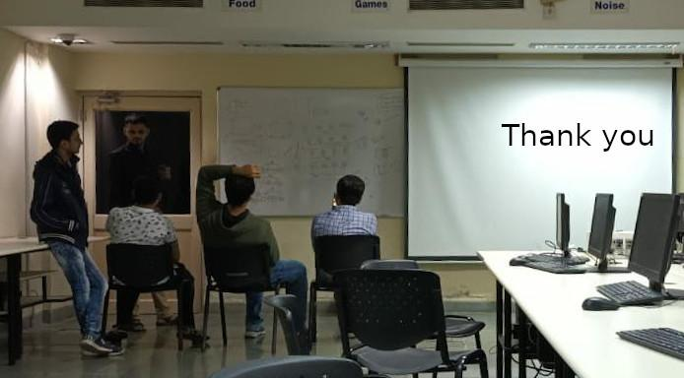

Slide 36
References
Microsoft Research Talk:
Medium: https://medium.com/cambridge-quantum-computing/quantum-natural-language-processing-748d6f27b31d

Slide 37
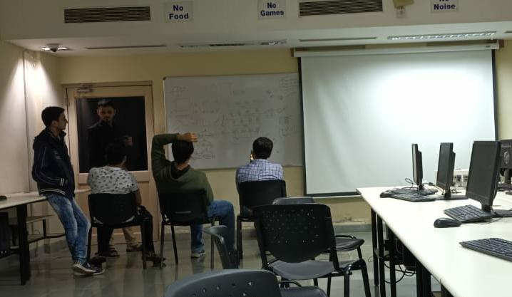
Thank you

